Slide 1
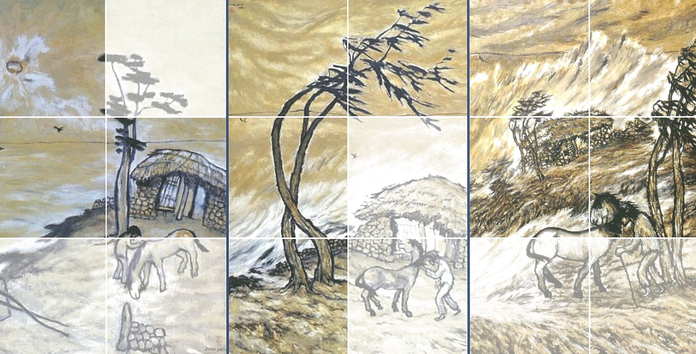
Recent progress on the seasonal prediction tropical cyclones
Eun Jeong CHA Meso-scale research team National Institute of Meteorological Sciences Korean Meteorological Administration
Republic of Korea
Typhoon(Si Ji Byun,1988)

Slide 2
Content
1. Background
2. Purpose 3. Current status 4. Procedure 5. Model 6. Conclusion 7. Discussion

Slide 3
1. Background
(1) The 15th IWS (1-2. December. 2020, Video conference) * POP1: Development of Typhoon seasonal prediction system(KMA) Dr. Lei(CMA), Dr. Yamaguchi(JMA) … Seasonal prediction for 2020 summer and fall - July 2020: No TC - October: larger than normal (2) Tropical cyclone and Climate change (3) Long term plan for DRR, water cycle, policy maker
Month | 1 | 2 | 3 | 4 | 5 | 6 | 7 | 8 | 9 | 10 | 11 | 12 | Total
30-yr ave. | 0.3 | 0.1 | 0.3 | 0.6 | 1.0 | 1.7 | 3.6 | 5.8 | 4.9 | 3.6 | 2.3 | 1.2 | 25.6
2020 | - | - | - | - | 1 | 1 | NO | 7 | 4 | 7 | 2 | 1 | 23
2021* | - | 1 | - | 1 | 1 | 2 | 3 | 4 | 4 | 4 |  |  | 20
* 2021: tentative track, will be confirmed

Slide 4
2. Purpose
- Review the current status of the seasonal TC predictions - Suggestion for new research topics

Slide 5
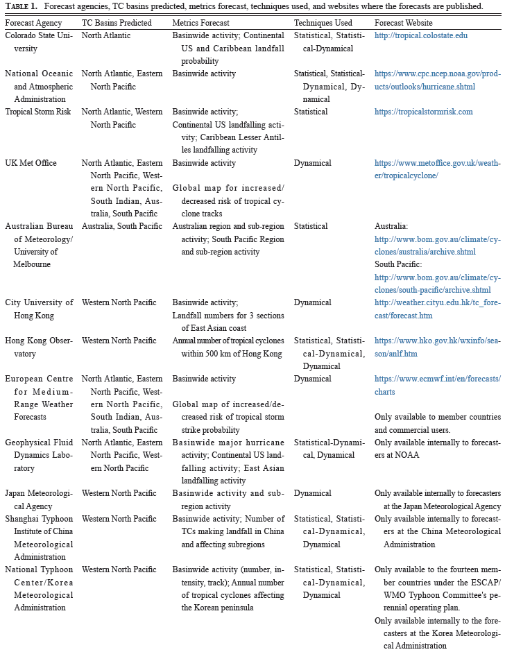
3. Current status
(Klotzbach et al. 2019, TCRR) Seasonal tropical cyclone forecasting (1) Statistical model (2) Statistical-Dynamical model(hybrid model) (3) Dynamical model

Slide 6
Main Mechanism of the TC seasonal prediction
Neville Nicholls (1979, 1984, 1985) initiated seasonal TC forecasts at the Australian Bureau of Meteorology for the Australian region, and William Gray (1984a, b) started seasonal TC forecasts at Colorado State University for the Atlantic Basin.
Chan et al. (1998, 2001) expanded seasonal predictions to the WNP. These researchers developed statistical models based on the relationships between TC activity and factors such as sea surface temperature (SST) and monsoons.
Vitart et al. (1997) and Vitart and Stockdale (2001) introduced a hybrid statistical–dynamical forecast that uses model-predicted SSTs for seasonal Atlantic TC predictions.
Many operational organizations currently use statistical–dynamical models for seasonal TC forecasts.

Slide 7
4. Procedure
1. Analyzing the current characteristics of atmospheric and oceanic variables related to TC activity, such as SST, monsoons, convection, Madden–Julian Oscillation (MJO), and circulation of the Pacific High and the Tibetan High.
2. Finding years with climatological characteristics similar to those of the current year based on step (i), such as El Niño/La Niña years and strong/weak monsoon activity.
3. Examining the results of four models: a statistical model, a dynamical model, and statistical–dynamical models Ⅰ and Ⅱ.
4. Comparing the forecasts of other organizations, such as the European Center for Medium -Range Weather Forecasts, Tropical Storm Risk, Hong Kong University, and the International Research Institute for Climate and Society.
5. Preparing a seasonal forecast draft, discussing it at a joint climate–TC expert meeting, and making the final decisions.
6. Releasing the seasonal TC forecast in the third week of May for summer and in the third week of August for fall
7. Evaluating the forecast after the TC season to better understand the discrepancies between the forecasts and observations and improve future predictions.

Slide 8
5. Model
 | Statistical | Statistical-dynamical model (Ⅰ) | Dynamical model | Statistical-dynamical model (Ⅱ)
Developer/References (year) | KMA/Kwon et al. (2007) | KMA/Kim et al., (2012a), Ho et al., (2013) | KMA/KMA (2014) | KMA/Yang et al. (2018)
Predictors (Sources) | NCEP reanalysis data (SLP, 500-hPa gpm, 850-hPa T, 850-hPa W, SST) *May- Dec. June-August, July-September August-October September-November for WNP TC frequency *June-August, July-September August-October September-November for KP-influence TC frequency | NCEP CFSv2 dynamic seasonal forecast data (200-hPa W, vertical wind shear, 850-hPa vorticity, SST) | GloSea5 seasonal forecast data (SLP, 10-m W, 300-hPa W, 850-hPa W, 300-hPa T, 500-hPa T, 700-hPa T, 850-hPa vorticity) | GloSea5 seasonal forecast data (SST, SOI)
Characteristics | Multiple linear regression model based on ensemble model | NCEP CFSv2 + Track pattern-based model | GloSea5 | GloSea5 + Multiple linear regression model
Products | WNP TC frequency, KP-influence TC frequency | WNP TC frequency, Probability of track density | WNP TC frequency, Probability of track density | WNP TC Frequency

Slide 9
Validation
(1) Method: Error rate, Tercile probability test, Categorical forecast(Heidke skill) (2) Period: 2014-2020 (JJA: June-July-August / SON: September-October-November)

Slide 10
(1) Error rate(JJA)
Table 2. Error rates for the number of TCs occurred during summer (JJA) and fall (SON) from 2014∼2020. The unit is %. A '-' indicates that no prediction data is available. The underlined numbers indicate the negative error rates. The bold numbers indicate the smallest error rate among the four models for the year
Season | Year | Observation | Official Prediction |  | Model
 |  |  |  |  | Statistical |  | Statistical -Dynamical (Ⅰ) |  | Dynamical |  | Statistical -Dynamical (Ⅱ)
 |  |  | Pre. | error rate | Pre. | error rate | Pre. | error rate | Pre. | error rate | Pre. | error rate
Summer (JJA) | 2014 | 8 | 10∼12 | 25〜50 | 12 | 50 | 18 | 125 | 10 | 25 | - | -
 | 2015 | 9 | 11∼14 | 22〜55 | 12 | 33.3 | 11.6 | 28.9 | 13.8 | 53.3 | - | -
 | 2016 | 11 | 7∼10 | -(36〜9) | 9 | -18.2 | 10.1 | -8.2 | 7 | -36.4 | - | -
 | 2017 | 14 | 8∼13 | -(42〜7) | 10 | -28.6 | 13.1 | -6.4 | 11.2 | -20 | 8.3 | -40.7
 | 2018 | 18 | 9∼12 | -(50〜33) | 12.2 | -32.2 | 12.2 | -32.2 | 15 | -16.7 | 9.6 | -46.7
 | 2019 | 10 | 11∼13 | 10〜30 | 11.2 | 12 | 13.6 | 36 | 13.4 | 34 | 10.6 | 6
 | 2020 | 9 | 9∼11 | 0〜22 | 9.2 | 2 | 9.2 | 2 | 14.8 | 64 | 7.1 | -21.1

Slide 11
(1) Error rate(SON)
Table 2. Error rates for the number of TCs occurred during summer (JJA) and fall (SON) from 2014∼2020. The unit is %. A '-' indicates that no prediction data is available. The underlined numbers indicate the negative error rates. The bold numbers indicate the smallest error rate among the four models for the year
Season | Year | Observation | Official Prediction |  | Model
 |  |  |  |  | Statistical |  | Statistical -Dynamical (Ⅰ) |  | Dynamical |  | Statistical -Dynamical (Ⅱ)
 |  |  | Pre. | error rate | Pre. | error rate | Pre. | error rate | Pre. | error rate | Pre. | error rate
Fall (SON) | 2014 | 8 | 10∼12 | 25〜50 | 10.2 | 27.5 | - | - | 11.4 | 42.5 | - | -
 | 2015 | 10 | 8∼12 | 20 | 8.2 | -18 | 13.8 | 38 | 8.8 | -12 | - | -
 | 2016 | 14 | 8∼12 | -(43〜14) | 8 | -42.9 | 13.4 | -4.3 | 14.2 | 1.4 | 8.6 | -38.6
 | 2017 | 10 | 9∼12 | -10〜+20 | 10 | 0 | 13.9 | 39 | 15.4 | 54 | 8.7 | -13
 | 2018 | 8 | 9∼12 | 13〜50 | 10.8 | 35 | 12.5 | 56.3 | 17 | 112.5 | 9.2 | 15
 | 2019 | 16 | 9∼12 | -(44〜25) | 9.9 | -38.1 | 15.2 | -5 | 13.3 | 16.8 | 8 | -50
 | 2020 | 12 | 11∼13 | -8〜+8 | 10.2 | -21.5 | 13.2 | 1.5 | 14.8 | 13.8 | 6.9 | -46.9

Slide 12
(2) Tercile probability test(JJA)
Table 3. Validation results of tercile probability test in summer (JJA) and fall (SON) from 2014∼2020. Blank denotes ‘Near Normal (NN)’. A '-' indicates that no prediction data is available.
Season | Year | Observation |  | Official Prediction |  | Model
 |  |  |  |  |  | Statistical |  | Statistical-dynamical (Ⅰ) |  | Dynamical
Summer (JJA) | 2014 | 8 | BN | 11 |  | 12 |  |  |  | 10
 | 2015 | 9 |  | 12.5 |  | 12 |  | 11.6 |  | 13.8
 | 2016 | 11 |  | 8.5 |  | 9 |  | 10.1 |  | 7 | BN
 | 2017 | 14 | AN | 10.5 |  | 10 |  | 13.1 | AN | 11.2
 | 2018 | 18 | AN | 10.5 |  | 12.2 |  | 12.2 |  | 15 | AN
 | 2019 | 10 |  | 12 |  | 11.2 |  | 13.6 | AN | 10
 | 2020 | 9 |  | 10 |  | 9.2 |  | 9.2 |  | 14.8 | AN

Slide 13
(2) Tercile probability test(SON)
Table 3. Validation results of tercile probability test in summer (JJA) and fall (SON) from 2014∼2020. Blank denotes ‘Near Normal (NN)’. A '-' indicates that no prediction data is available.
Season | Year | Observation |  | Official Prediction |  | Model
 |  |  |  |  |  | Statistical |  | Statistical-dynamical (Ⅰ) |  | Dynamical
Fall (SON) | 2014 | 8 | BN | 11 |  | 10.2 |  | - | - | 11.4
 | 2015 | 10 |  | 10 |  | 8.2 |  | 13.8 | AN | 8.8
 | 2016 | 14 | AN | 10 |  | 8 | BN | 13.4 | AN | 14.2 | AN
 | 2017 | 10 |  | 10.5 |  | 10 |  | 13.9 | AN | 15.4 | AN
 | 2018 | 8 |  | 10.5 |  | 10.8 |  | 12.5 | AN | 17 | AN
 | 2019 | 16 | AN | 11.5 |  | 9.9 |  | 15.2 | AN | 13.3 | AN
 | 2020 | 12 |  | 12 |  | 10.2 |  | 13.2 | AN | 14.8 | AN

Slide 14
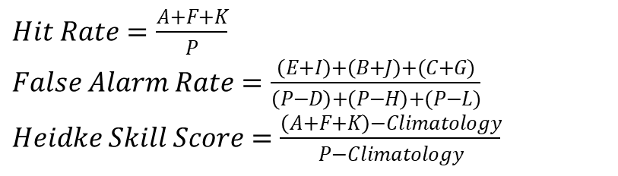
(3) Evaluation of categorical forecasts
Table 4. The contingency table for tercile probability (AN, NN, BN) comparing observation (Obs) and prediction (Pre). Bold and red values denote correct predictions.
Pre Obs | AN | NN | BN | Total
AN | A | B | C | D
NN | E | F | G | H
BN | I | J | K | L
Total | M | N | O | P
$Hit Rate=\frac{A+F+K}{P}$
$False Alarm Rate=\frac{\left(E+I\right)+\left(B+J\right)+(C+G)}{\left(P−D\right)+\left(P−H\right)+(P−L)}$
$Heidke Skill Score=\frac{\left(A+F+K\right)−Climatology}{P−Climatology}$

Slide 15
(3) Evaluation of categorical forecasts
Table 5. Verification of seasonal WNP TC predictions in summer (JJA) and fall (SON) from 2014∼2020 using various skill score methods. The bold numbers indicate the best of all results for the year.
Season | Methods | Official prediction | Statistical | Statistical-dynamical (Ⅰ) | Dynamical
Summer (JJA) | HR | 0.43 | 0.57 | 0.57 | 0.71
 | FAR | 0.29 | 0.21 | 0.21 | 0.14
 | HR | -2.54 | -2.4 | -2.4 | -2.14
Fall (SON) | HR | 0.57 | 0.43 | 0.50 | 0.29
 | FAR | 0.21 | 0.29 | 0.25 | 0.36
 | HSS | 0.32 | 0.09 | 0.21 | -0.14

Slide 16
6. Conclusion
In this study, we described the seasonal WNP TC prediction system of the KMA and evaluated the prediction results for the period 2014–2020. The official forecasts of the KMA are determined based on a combination of climatological data analysis, multiple model results, and expert opinions.
The seasonal prediction models use various atmospheric and oceanic variables related to TC activity, such as SST, monsoon, convective activity, and ENSO.
The official forecasts are issued in May for summer and in August for fall every year and are available on its website under the POP of the Typhoon Committee.
The evaluation showed that the prediction results were diverse, with no dominant trends or consistent results, making it difficult to identify the best model.
We also found that all official predictions for JJA over the evaluation period were Near Normal, indicating that all forecasts were within the range of the climatological mean values.
Some models also showed biased Neal Normal or Above Normal predictions. Especially for JJA, the HSSs showed that the official and the models’ forecasts were not skillful.

Slide 17
7. Discussion
1. The statistical model should be updated using smarter predictors of WNP TC frequency trained on larger datasets that include recent data.
2. Ensemble averaging methods of the statistical model that can smooth the number of predicted TCs, reduce variability, and ultimately produce unskillful forecasts should be avoided.
3. Research into the atmospheric/oceanic environments and climate indices that affect TC activity in the WNP should continue.
4. The changes in TC activity due to climate change related to global warming should be investigated.
5. Statistical models should be established by subdividing the predictands to consider intra-basin differences in the relationships between WNP TCs and environmental variables.
6. Case studies should be enhanced to accumulate experience of extreme events, such as ENSO years and the highest TC frequency years.
7. New technologies, such as artificial intelligence, should be introduced.

